Slide 1
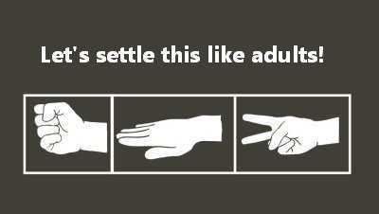
Managing Conflict
Bob Marshall, MD MPH MISM FAAFP
DoD/MAMC Clinical Informatics Fellowship

Slide 2
Learning Objectives
Overview of conflict
Discuss which conflict needs to be managed
Preventing conflict
Discuss the Thomas-Kilmann Conflict Mode Instrument
Discuss when and when not to use different conflict management styles

Slide 3
Conflict Overview
Conflict in the workplace is a normal occurrence in most organizations
Can be defined simply as tension, and it can offer benefits, as well as disadvantages, in the workplace.
Wherever people work together, conflict is likely to arise
It presents a challenge to which management must respond constructively
Interpersonal conflict includes personality clashes and difficulty working with others, both of which can lead to anger and exchange of negative comments
Workplace complaints include disagreement with policies and procedures, management decisions and individual entitlements

Slide 4
Causes of Conflict
One of the most common causes of workplace conflict is the personality clash
Individuals all have different values and beliefs, which affects the way they approach work and problem-solving
Clashes occur when workers have difficulty understanding or accepting others’ methods or ideals
Other causes include conflicting needs, poor communication that causes misunderstandings, scarcity of resources that results in competition between workers and poor performance by some employees that causes additional workload for others

Slide 5
Preventing Conflict
Prevent workplace conflicts from arising by hiring staff with balanced personality types and by fostering a company culture based on shared values and beliefs
Establish ground rules for all employees, such as a code of conduct and a disciplinary procedure for contravening the code
Set priorities that enable workers to know what is expected of them and how to achieve it
Promote effective listening to help employees develop their awareness of others’ methods and viewpoints

Slide 6
Conflict Myths
Conflict is always bad/negative and should be avoided at all costs
Conflict always has to be an adversarial win or lose situation
Teams that experience conflict will never be effective
It is okay for leaders to ignore workplace conflict; it will go away on its own
It is wise to approach conflict with the single methodology you are most comfortable with using

Slide 7
Potential Benefits of Conflict
Increased understanding
Going through the process of resolving conflict expands people’s awareness, and gives them an insight into how they can achieve their goals without undermining others
Better group cohesion
When you resolve conflict effectively, team members can develop stronger mutual respect, and a renewed faith in their ability to work together
Improved self-knowledge
Conflict pushes individuals to examine their goals and expectations closely, helping them to understand the things that are most important to them, sharpening their focus, and enhancing their effectiveness

Slide 8
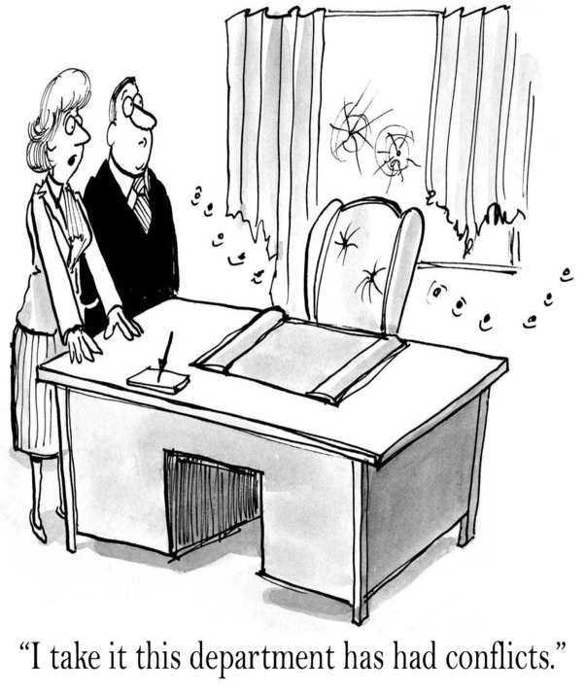
Thomas-Kilmann Model

Slide 9
Thomas-Kilmann Conflict Mode Instrument
TKI is a tool that assesses an individual’s typical behavior in conflict situations, describing the behaviors along two dimensions: assertiveness and cooperativeness
TKI helps leaders understand how interpersonal group dynamics are affected by conflict-handling styles, as well as helps them make informed decisions about choosing an appropriate style when approaching a conflict situation

Slide 10
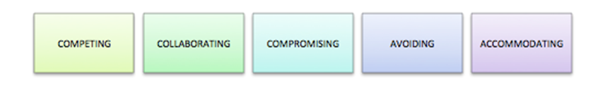
TKI Conflict-Handling Styles

Slide 11
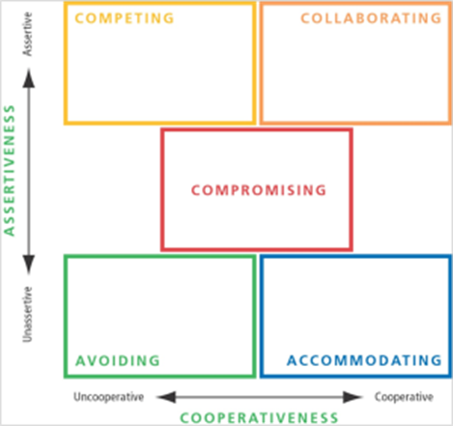

Slide 12
Competing Style
You try to satisfy your own concerns at another’s expense
You win and they lose
Some people think competing is bad.
That is not true; competition is necessary at times, based on the situation
However, if you only manage conflict through competition, then you are ineffectively managing situations and people

Slide 13
When to Use
There is an emergency that requires quick and decisive action
When unpopular steps are necessary, such as enforcing rules, disciplining team members or cutting costs
The company is on the line and you know what it will take to get it back on track
Some people will take advantage of those who display noncompetitive behavior; if this occurs, it may be necessary to adopt a competitive strategy to protect yourself and your interests
Job interviews, negotiating pay and getting on your manager’s calendar

Slide 14
When Not to Use
If the outcome doesn’t really matter to you and there is no reason to compete
When you are not the subject matter expert, competing for the strongest voice is inappropriate and will create even more conflict
When you are angry and want to prove a point
NOTE: You may be overusing the competing mode of conflict-handling if you find yourself surrounded by “yes people,” or if others are afraid to admit mistakes or ask you questions

Slide 15
Collaborating Style
You try to find a solution to conflict that satisfies all concerned—a win-win
Collaboration takes a lot of time, resources, energy and bandwidth
Though many leaders encourage collaboration, it is often difficult for both parties to get exactly what they want, which is why it is often used in high risk situations
Often, when people say “collaborate” they actually mean either “compromise” or just “work together”

Slide 16
When to Use
Your objective is to learn from the conflict
Collaborating is a good way to explore other people’s views
There are hard feelings between members of the conflict that need to be resolved to improve the organization as a whole
The concerns of both parties are too important to be compromised

Slide 17
When Not to Use
A quick decision is imperative to the situation
Resources are tight
The conflict is trivial, and doesn’t need the time necessary for collaborating
NOTE: You may be overusing the collaborative approach to conflict if others are uncommitted to your decisions or policies

Slide 18
Compromising Style
Your solution only partially satisfies each member in the conflict
There are no winners and no losers
Compromise is an acceptable solution
If you are a leader who only compromises, the team may start to game the system and ask for more than what they truly need as they know their leader will compromise during the negotiations

Slide 19
When to Use
The potential disruption involved with asserting your goals is not worth the effort
The opposing members of the conflict are of equal power standing
You realize the situation is complicated and needs more time to solve than is available
A temporary solution is needed
There is immense time pressure

Slide 20
When Not to Use
When compromising ultimately undermines the values and principles of the organization
If an attitude of gaming is noticed, which will deflect attention away from the merits of the actual issues at hand
NOTE: You may be overusing the compromising mode if the insistence on compromising takes away focus on larger issues, or if you notice a cynical climate of gamesmanship

Slide 21
Avoiding Style
You don’t try to satisfy yourself or other people involved in the conflict
Instead, you stay away from the situation entirely
This mode is used when emotions are running high
To be honest, Avoiding is a Band-Aid for the conflict situation; nothing is resolved and the topic is put into a parking lot until later
The fact is you will have to eventually deal with the conflict

Slide 22
When to Use
Emotions are high, and people need to cool down
The issue at hand is actually just a result of a much simpler issue that can be solved more easily
Your team is fully capable of solving the conflict without your involvement
More information should be gathered before facing the conflict, in order to resolve it more productively
The benefit of facing the conflict does not outweigh the cost of doing so
There are more pressing issues at hand

Slide 23
When Not to Use
The decision at hand must be made quickly
The core reason is to avoid a frank conversation
NOTE: You may be overusing the avoiding mode if there is coordination trouble due to waiting on input, there is an atmosphere of “walking on eggshells,” or decisions about important issues are being made by default

Slide 24
Accommodating Style
You are willing to sacrifice your own needs and desires for other people involved in the conflict
You lose and they win
Some people think accommodation equates to being a doormat
Accommodation is the best tool to use when you are not the subject matter expert, or when the outcome is not that important to you

Slide 25
When to Use
Preserving harmony is the most important aspect of the conflict situation
The issue at hand is much more important to the other person
You realize you are wrong; accommodating in this situation shows that you are reasonable
You want to build social credits for future use
You are outmatched; it would only damage your cause in the long run if you didn’t accommodate
Employee development is your goal; letting your team experiment and learn from their mistakes will enable that

Slide 26
When Not to Use
Safety and security are paramount to resolving the conflict
The outcome of the conflict is vital to the organization’s success
NOTE: You may be overusing the accommodating mode if discipline in the organization is lax, or if you feel your ideas and concerns don’t get the appropriate level of attention

Slide 27
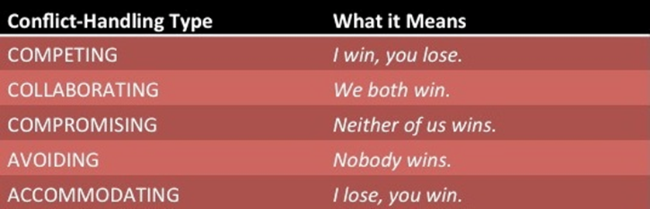

Slide 28
Final Note on TKI
To be most effective, leaders need to use all of these conflict styles
Being adaptable and nimble is a strength when it comes to facing conflict
Understanding these different ways of approaching conflict also develops Emotional Intelligence (EQ), another key element to successful leadership

Slide 29
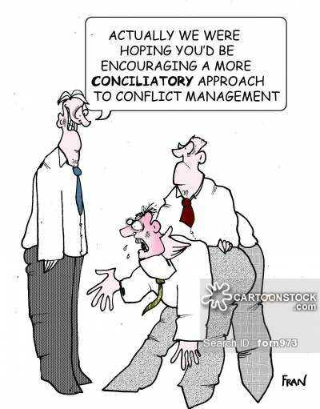
IBR Approach

Slide 30
The Interest-Based Relational Approach
When conflict arises, it's easy for people to get entrenched in their positions and for tempers to flare, voices to rise, and body language to become defensive or aggressive
You can avoid all of this by using the Interest-Based Relational (IBR) approach
Roger Fisher and William Ury developed the IBR approach and published it in their 1981 book, "Getting to Yes“
They argue that you should resolve conflicts by separating people and their emotions from the problem

Slide 31
More on the IBR Approach
IBR also focuses on building mutual respect and understanding, and it encourages resolving conflict in a united, cooperative way
The approach is based on the idea that the manager’s role is not simply to resolve conflict but to ensure that team members feel respected and understood, and that everyone appreciates their differences
During the process, the focus should be on everyone behaving courteously and consensually
The priority is to help each side develop an understanding of the other's position, and to encourage both to reach a consensus – even if that means agreeing to disagree

Slide 32
Effectively Using the IBR Approach
To use the IBR approach effectively, everyone involved should listen actively and empathetically, have a good understanding of body language, be emotionally intelligent, and understand how to employ different anger management techniques.
In particular, everyone need to follow six steps:
Make sure that good relationships are a priority
Treat the other person with respect
Do your best to be courteous, and to discuss matters constructively

Slide 33
The Six Steps Continued 1 of 2
Separate people from problems
Recognize that, in many cases, the other person is not "being difficult" – real and valid differences can lie behind conflicting positions
By separating the problem from the person, you can discuss issues without damaging relationships
Listen carefully to different interests
You'll get a better grasp of why people have adopted their position if you try to understand their point of view

Slide 34
The Six Steps Continued 2 of 2
Listen first, talk second
You should listen to what the other person is saying before defending your own position
They might say something that changes your mind
Set out the "facts"
Decide on the observable facts that might impact your decision, together
Explore options together
Be open to the idea that a third position may exist, and that you might reach it jointly

Slide 35
Key Points 1 of 2
The IBR approach may not be appropriate for all situations
For example, you may not be able to resolve differences in such a consensual, collaborative way if your organization is in a crisis
On these occasions, you may have to "pull rank" as a leader and make quick decisions about disputes and conflicts

Slide 36
Key Points 2 of 2
When you don't manage workplace conflict effectively effectively, real and legitimate differences between people can quickly get out of control, which can result in an irretrievable breakdown in communication
Use the IBR approach to resolve difficult conflict situations, by being courteous and non-confrontational, focusing on issues rather than individuals, and listening carefully to each person's point of view
When people listen and explore the facts, issues and possible solutions carefully, you can resolve conflict effectively

Slide 37
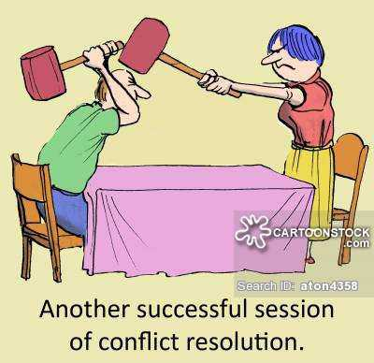
Questions

